Slide 1
Lecture 16: Bagging and Random Forest

Slide 2
Outline
Review of Decision Trees
Decision Trees for Regression
Bagging
Out of Bag Error (OOB)
Variable Importance
Random Forests

Slide 3
Learning Algorithm
To learn a decision tree model, we take a greedy approach:
Start with an empty decision tree (undivided feature space)
Choose the ‘optimal’ predictor on which to split and choose the ‘optimal’ threshold value for splitting by applying a splitting criterion
Recurse on on each new node until stopping condition is met
For classification, we label each region in the model with the label of the class to which the plurality of the points within the region belong.

Slide 4
Decision Trees for Regression

Slide 5
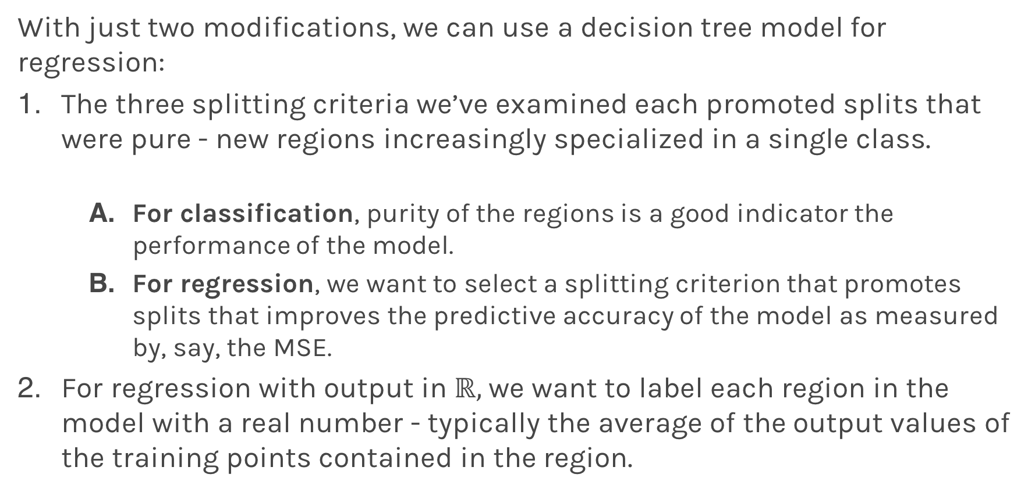
Adaptations for Regression
With just two modifications, we can use a decision tree model for regression:
The three splitting criteria we’ve examined each promoted splits that were pure - new regions increasingly specialized in a single class.
For classification, purity of the regions is a good indicator the performance of the model.
For regression, we want to select a splitting criterion that promotes splits that improves the predictive accuracy of the model as measured by, say, the MSE.
For regression with output in $ℝ,$ we want to label each region in the model with a real number - typically the average of the output values of the training points contained in the region.

Slide 6
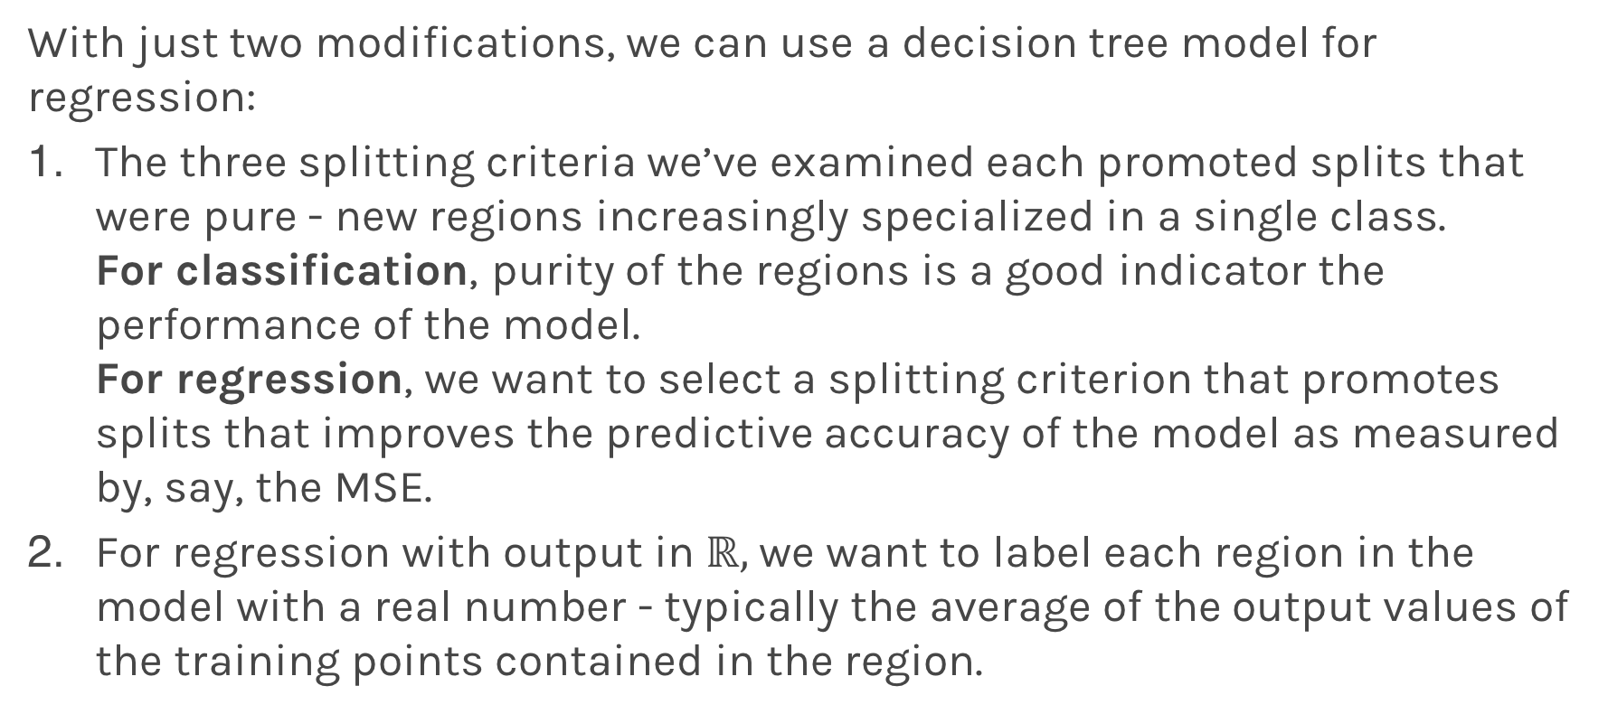
Adaptations for Regression
With just two modifications, we can use a decision tree model for regression:
The three splitting criteria we’ve examined each promoted splits that were pure - new regions increasingly specialized in a single class. For classification, purity of the regions is a good indicator the performance of the model. For regression, we want to select a splitting criterion that promotes splits that improves the predictive accuracy of the model as measured by, say, the MSE.
For regression with output in $ℝ,$ we want to label each region in the model with a real number - typically the average of the output values of the training points contained in the region.

Slide 7
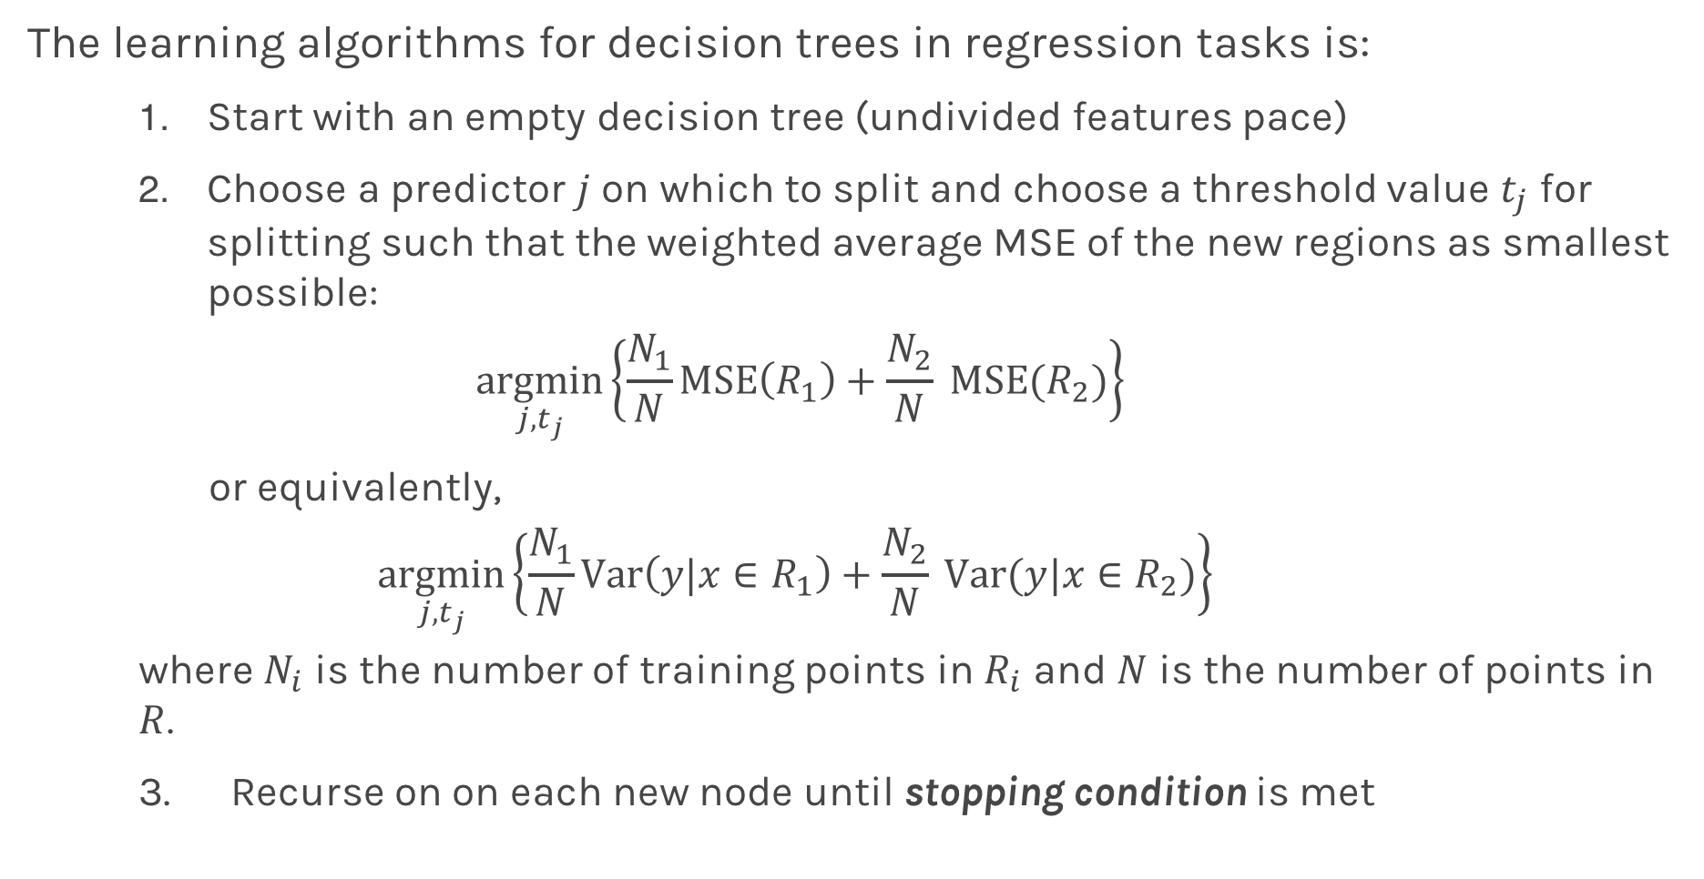
Learning Regression Trees
The learning algorithms for decision trees in regression tasks is:
Start with an empty decision tree (undivided features pace)
Choose a predictor $j$ on which to split and choose a threshold value $t_{j}$ for splitting such that the weighted average MSE of the new regions as smallest possible:
$$\underset{j, t_{j}}{argmin}\left\{\frac{N_{1}}{N}MSE\left(R_{1}\right)+\frac{N_{2}}{N} MSE(R_{2})\right\}$$
or equivalently,
$$\underset{j, t_{j}}{argmin}\left\{\frac{N_{1}}{N}Var\left(y|x∈R_{1}\right)+\frac{N_{2}}{N} Var(y|x∈R_{2})\right\}$$ where $N_{i}$ is the number of training points in $R_{i}$ and $N$ is the number of points in $R$.
3. Recurse on on each new node until stopping condition is met

Slide 8
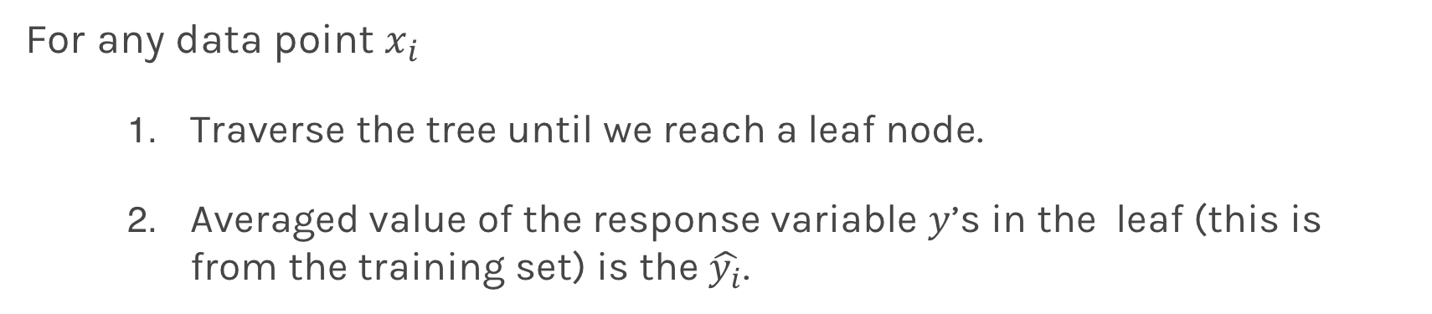
Regression Trees Prediction
For any data point $x_{i}$
Traverse the tree until we reach a leaf node.
Averaged value of the response variable $y$’s in the leaf (this is from the training set) is the $\hat{y_{i}}$.

Slide 9
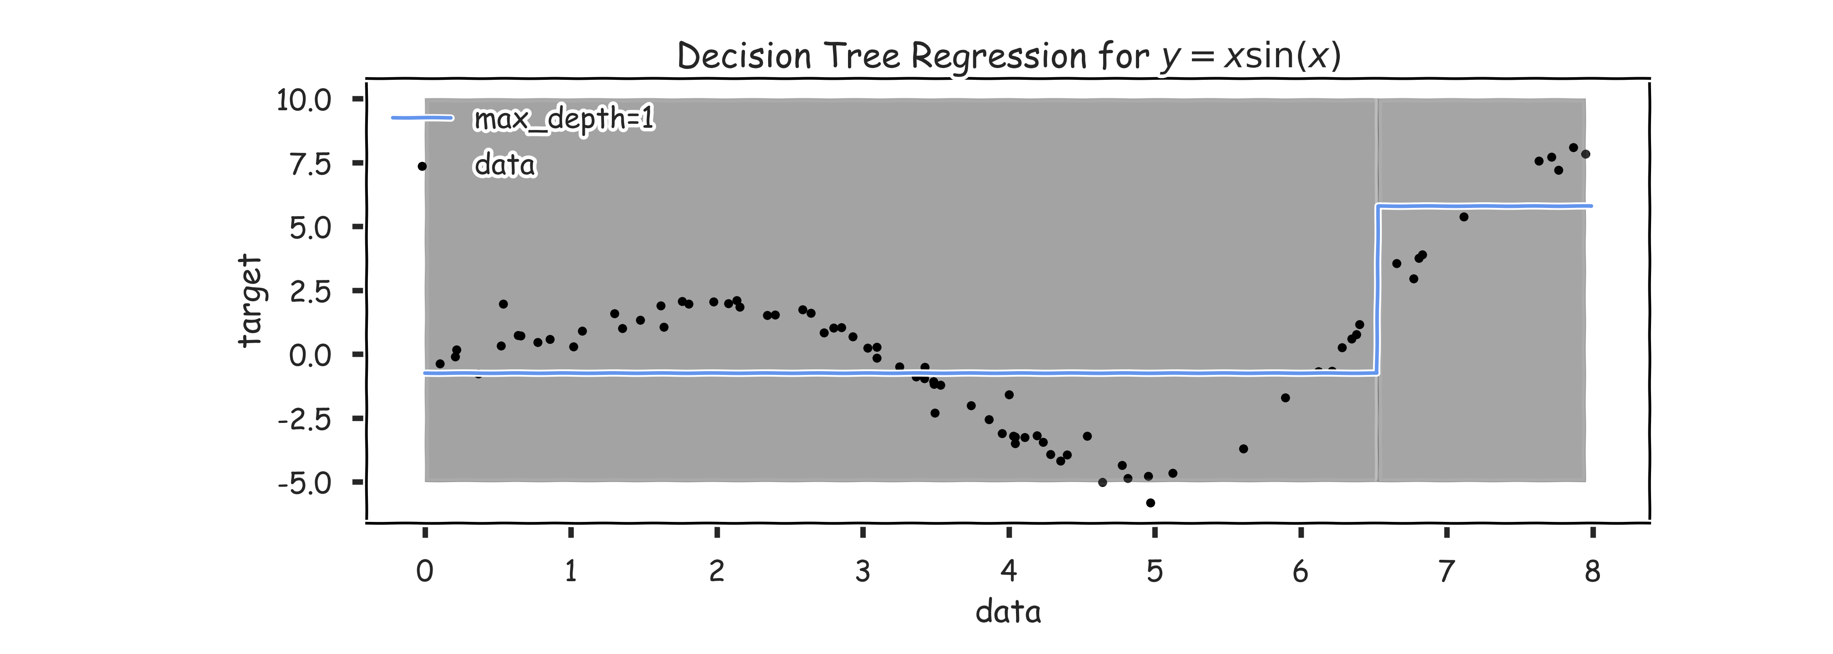
Regression Trees Prediction (grey scale represents MSE)

Slide 10
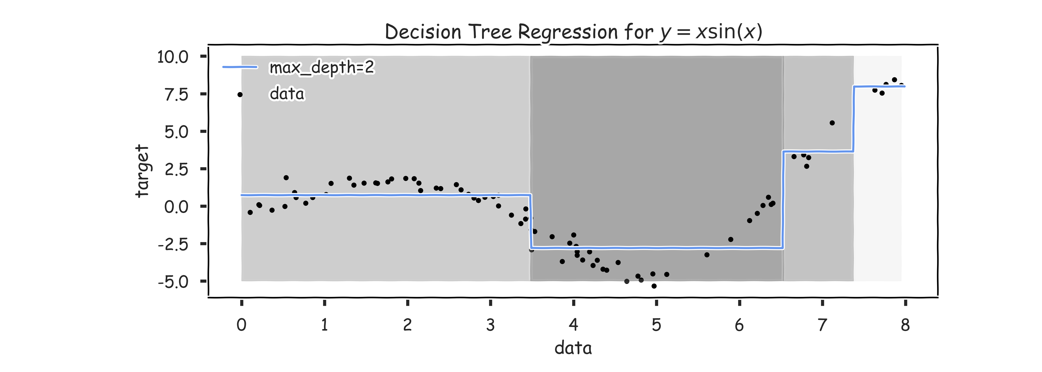
Regression Trees Prediction (grey scale represents MSE)

Slide 11
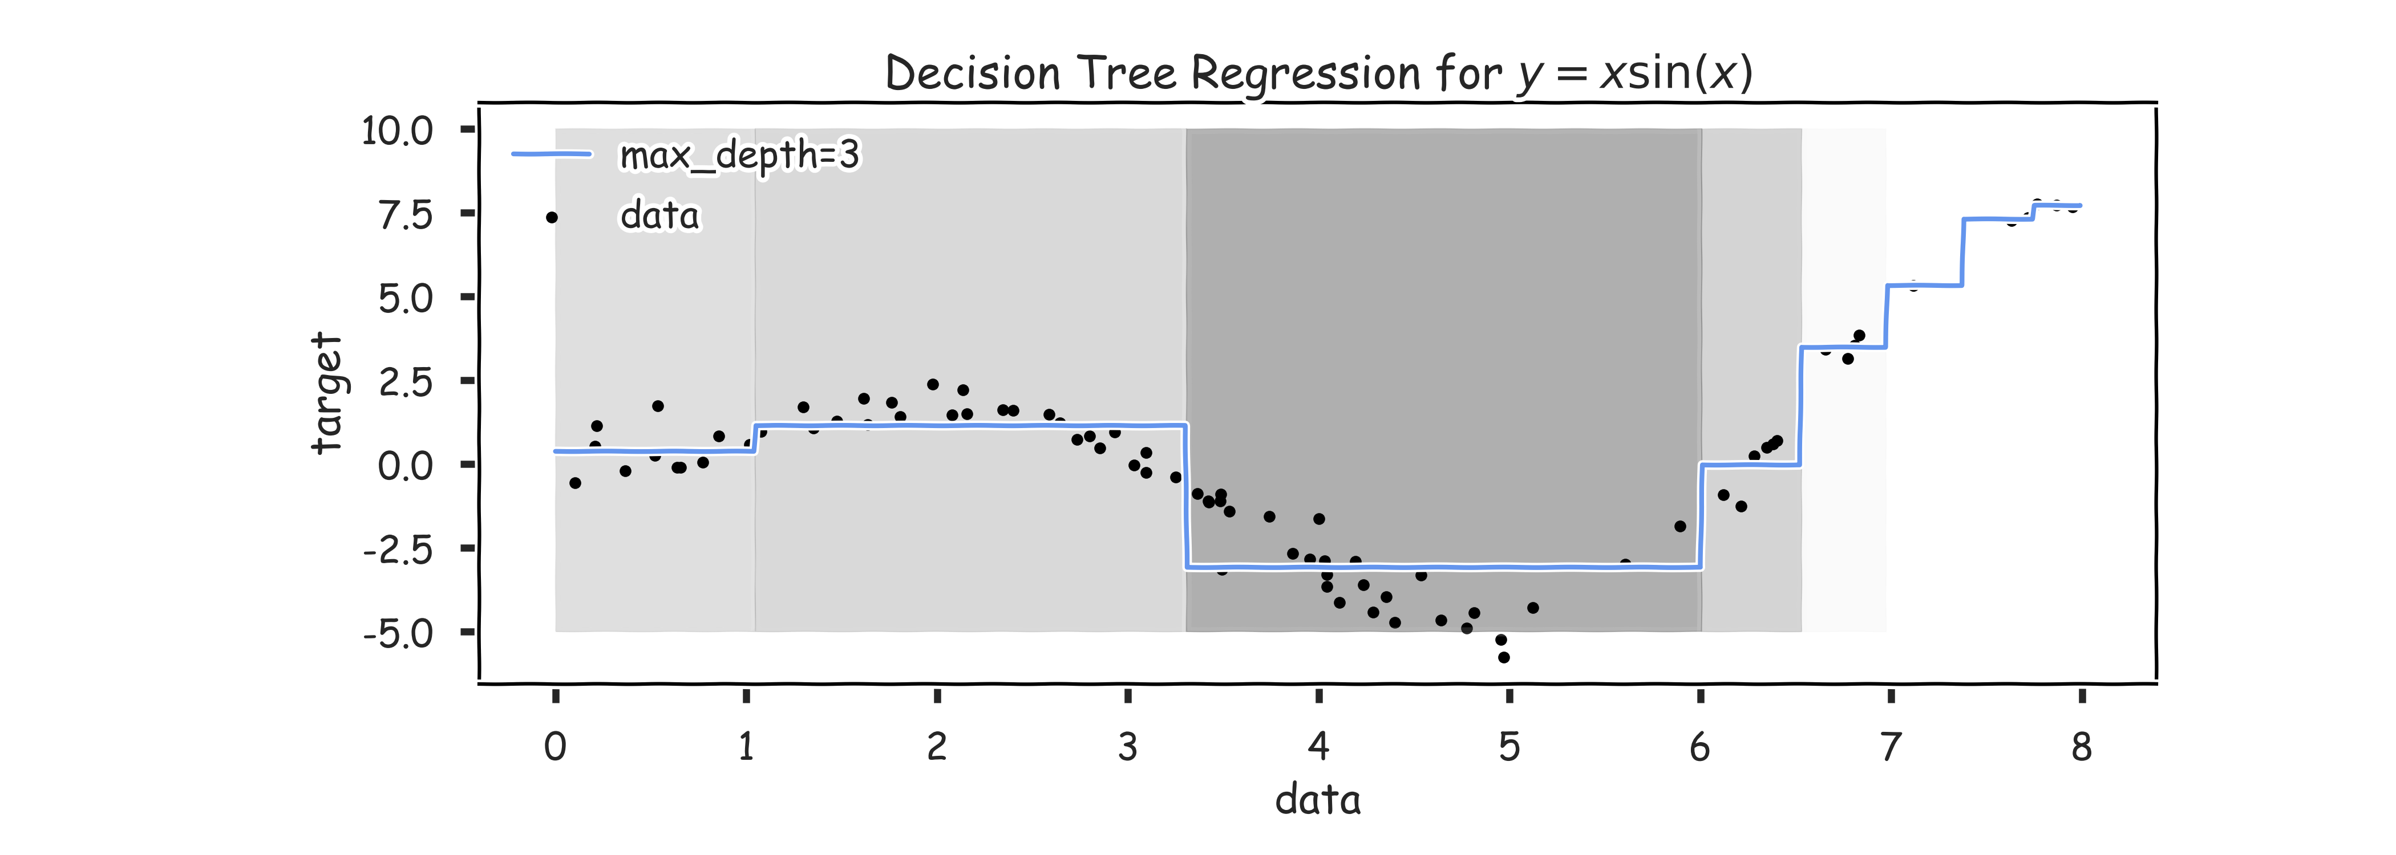
Regression Trees Prediction (grey scale represents MSE)

Slide 12
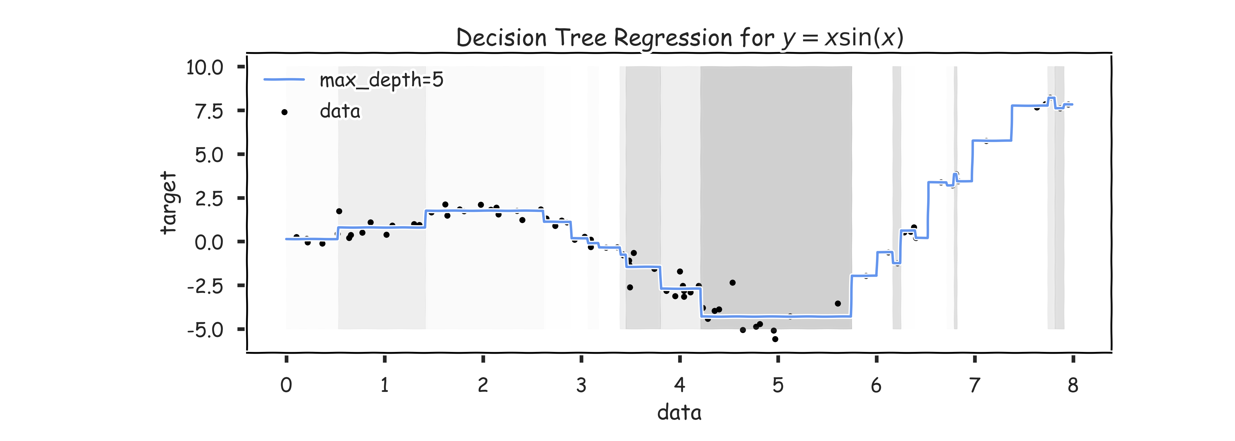
Regression Trees Prediction (grey scale represents MSE)

Slide 13
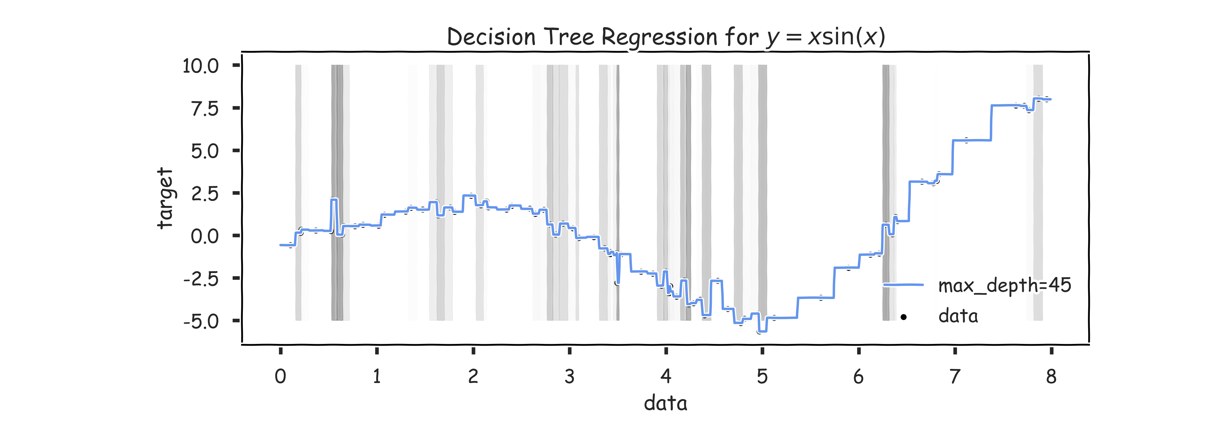
Regression Trees Prediction (grey scale represents MSE)

Slide 14
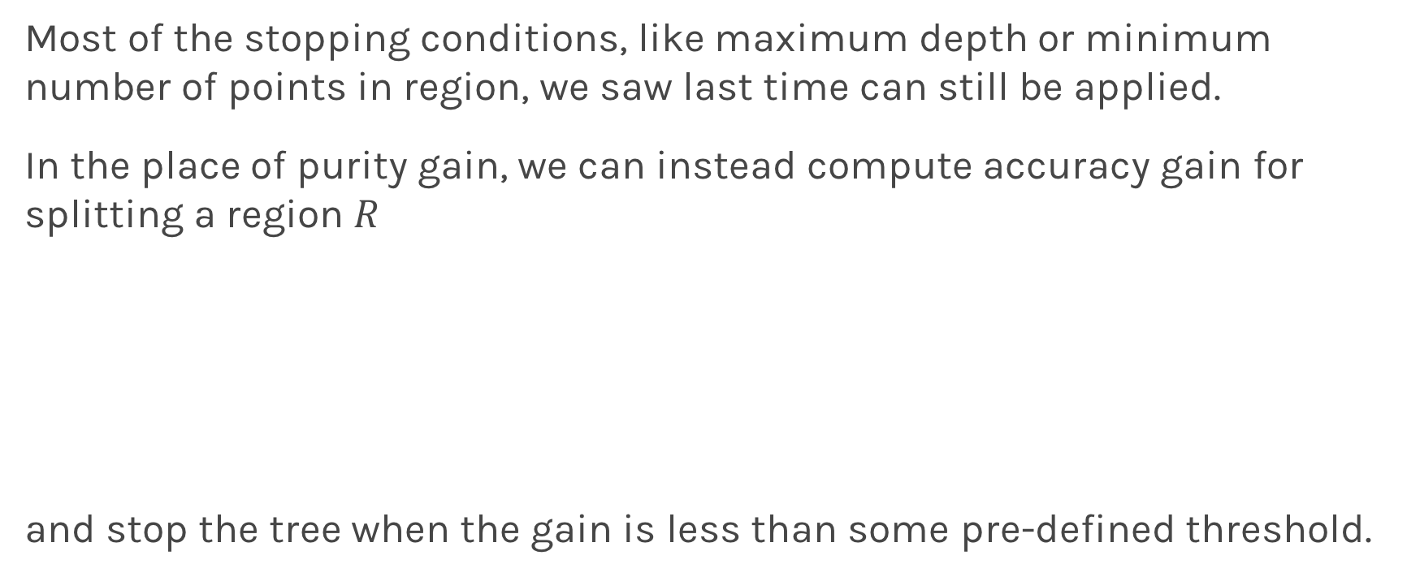
Stopping Conditions
Most of the stopping conditions, like maximum depth or minimum number of points in region, we saw last time can still be applied.
In the place of purity gain, we can instead compute accuracy gain for splitting a region $R$
and stop the tree when the gain is less than some pre-defined threshold.

Slide 15
Overfitting
Same issues as with classification trees. Avoid overfitting by pruning or limiting the depth of the tree and using CV.

Slide 16
Bagging

Slide 17
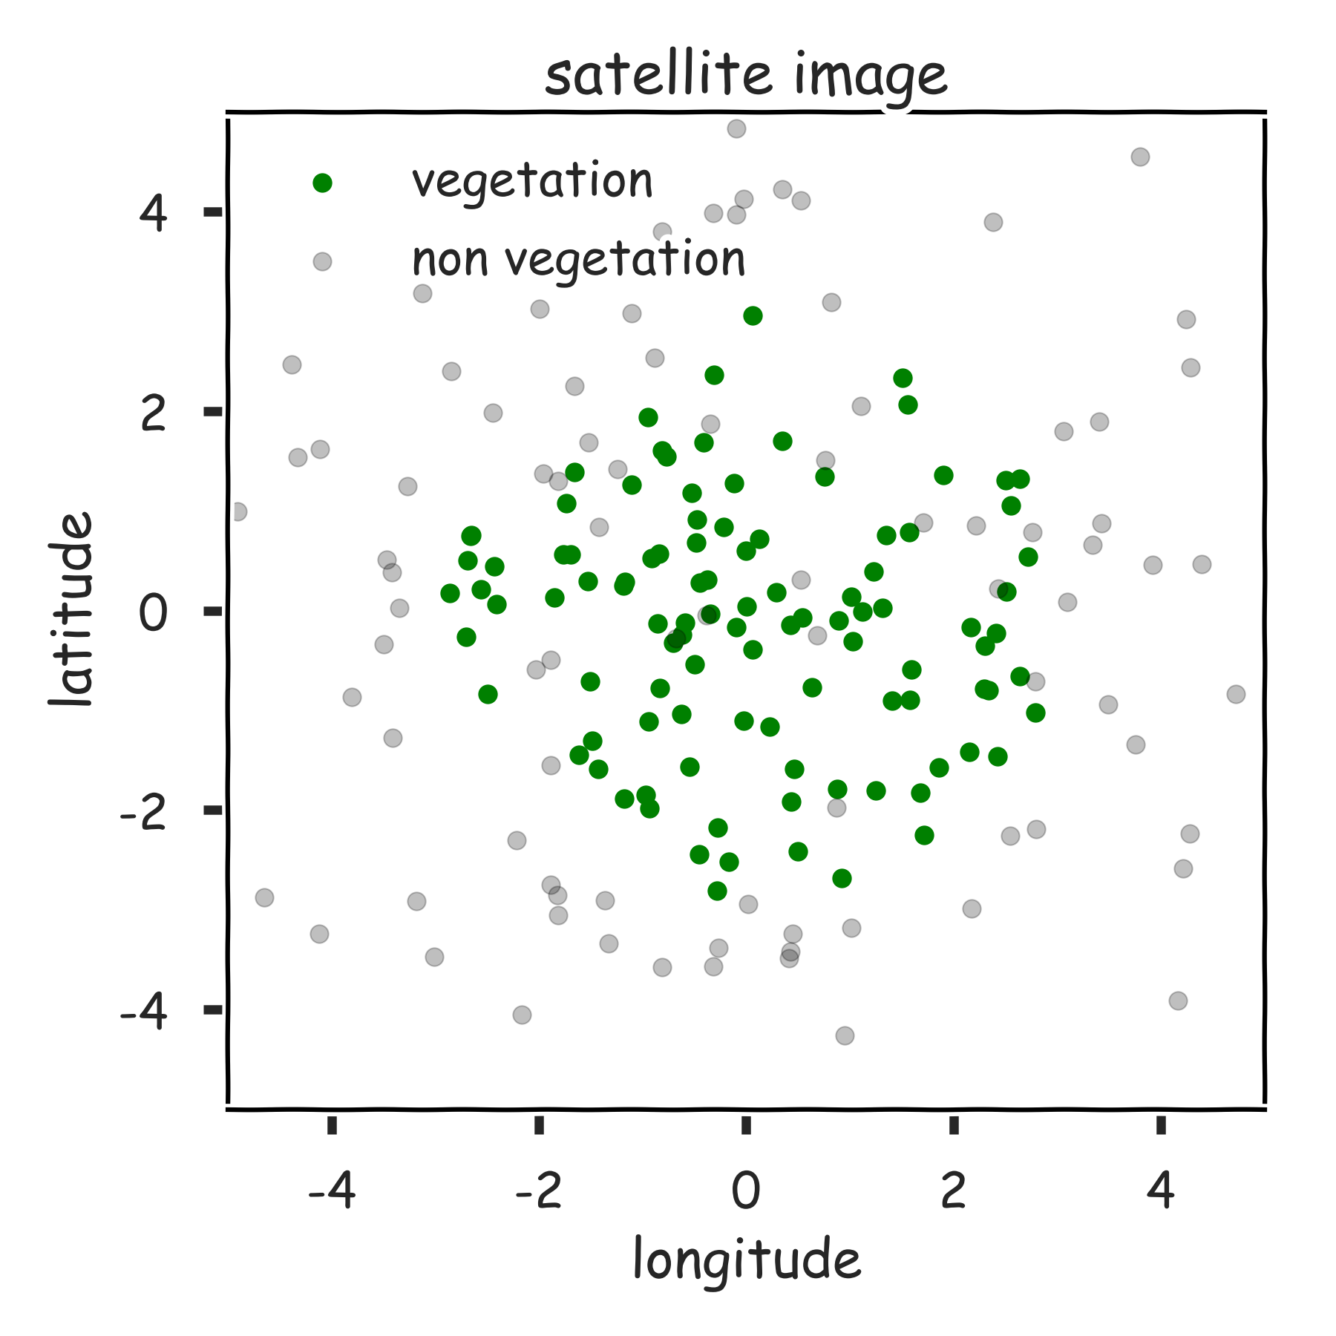
Reduce the variance

Slide 18
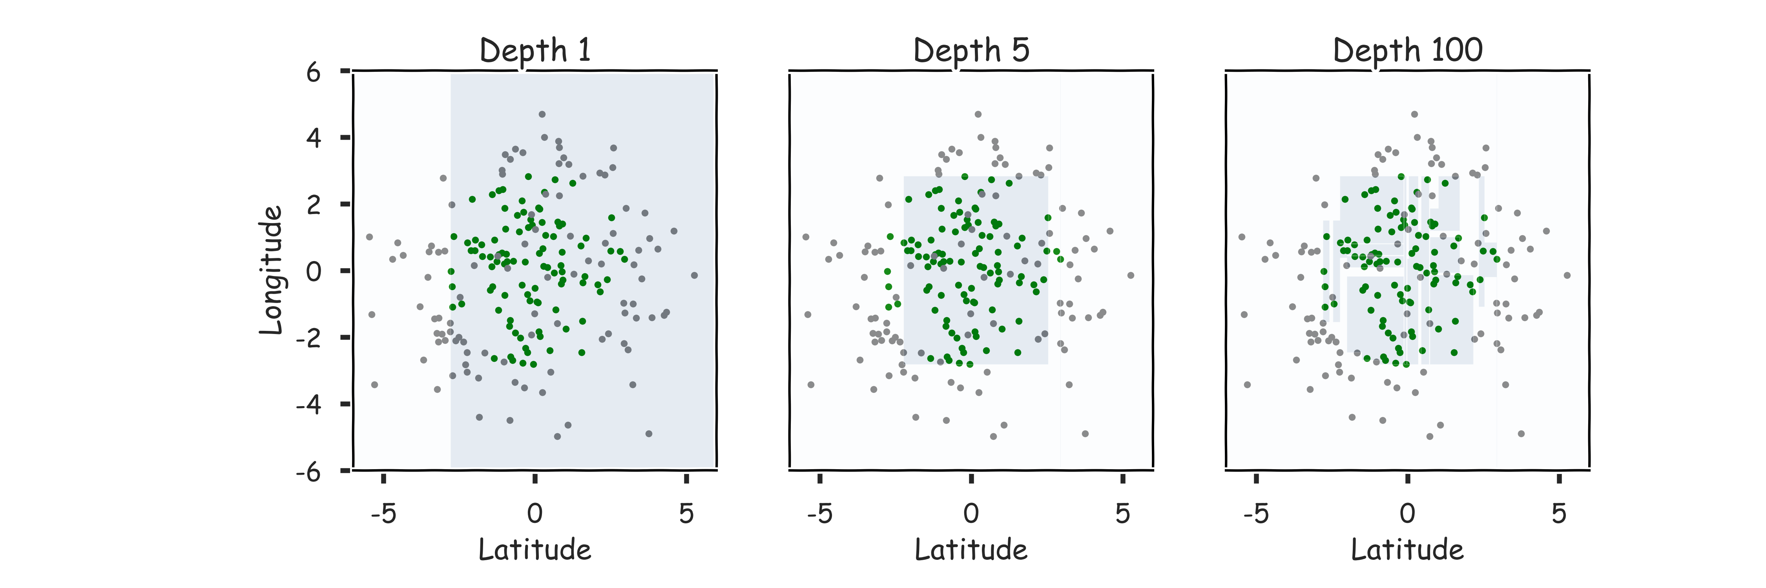
Hyper-parameters: Depth

Slide 19
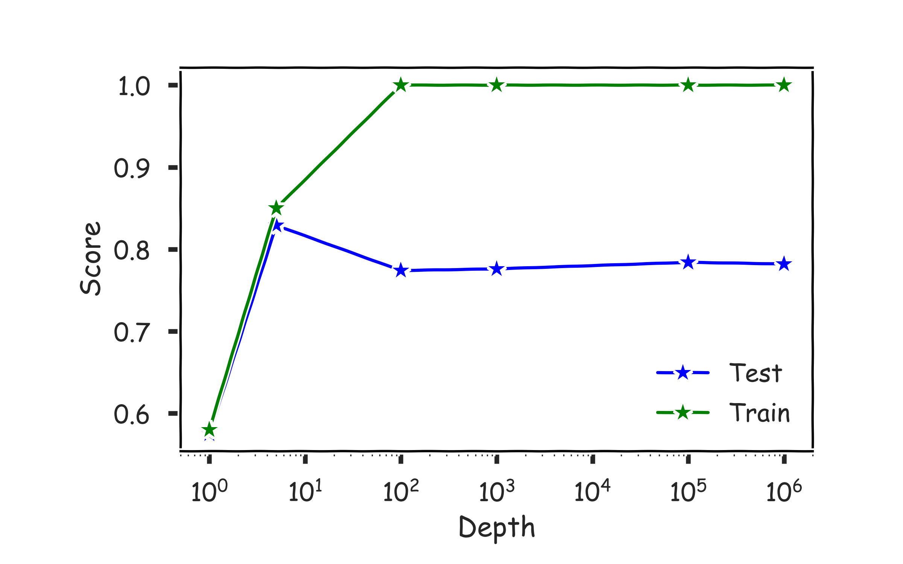
Hyper-parameters: Depth

Slide 20
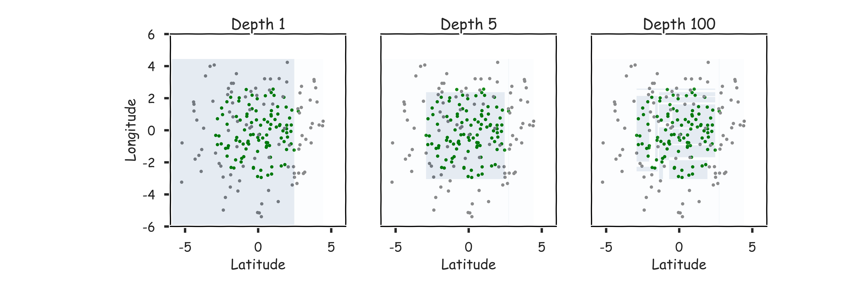
Magic realism: Bootstrap

Slide 21
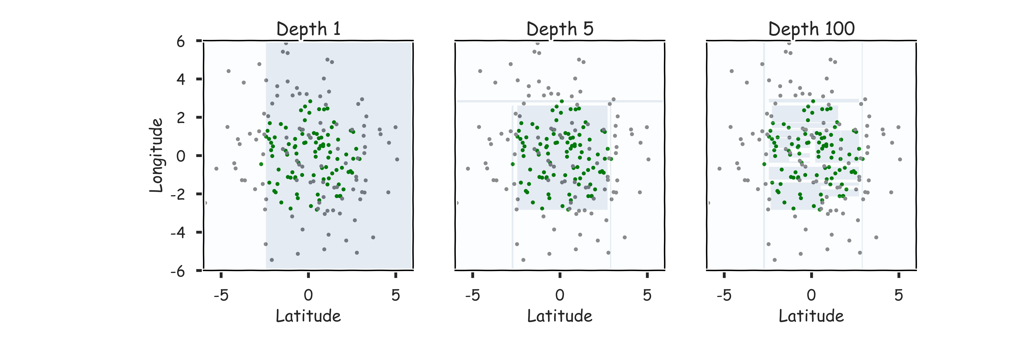
Magic realism: Bootstrap

Slide 22
Limitations of Decision Tree Models
Decision trees models are highly interpretable and fast to train, using our greedy learning algorithm.
However, in order to capture a complex decision boundary (or to approximate a complex function), we need to use a large tree (since each time we can only make axis aligned splits).
We’ve seen that large trees have high variance and are prone to overfitting.
For these reasons, in practice, decision tree models often underperforms when compared with other classification or regression methods.

Slide 23
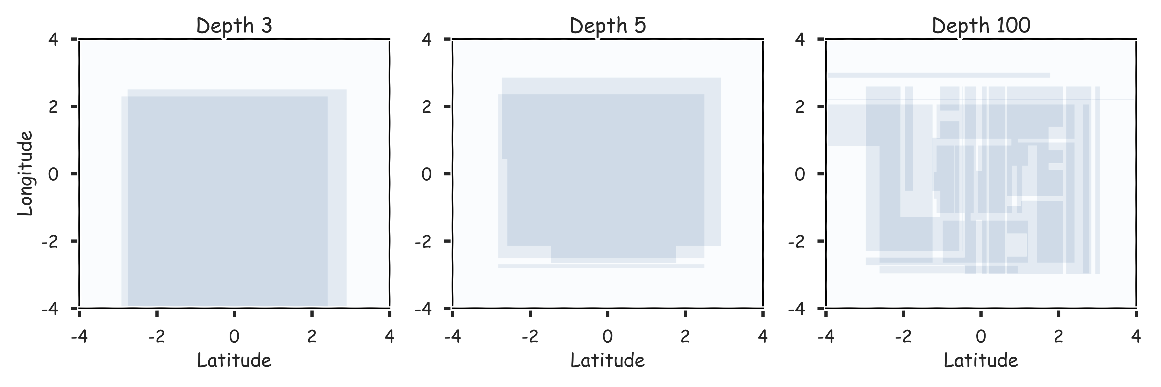
Combine them? 2 magic realisms

Slide 24
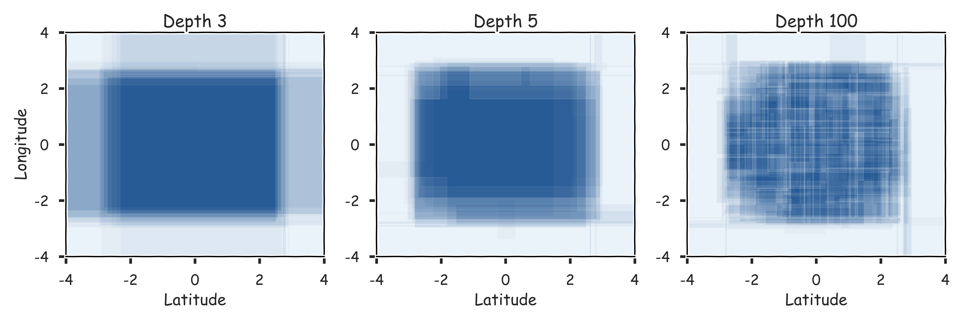
Combine them? 20 magic realisms

Slide 25
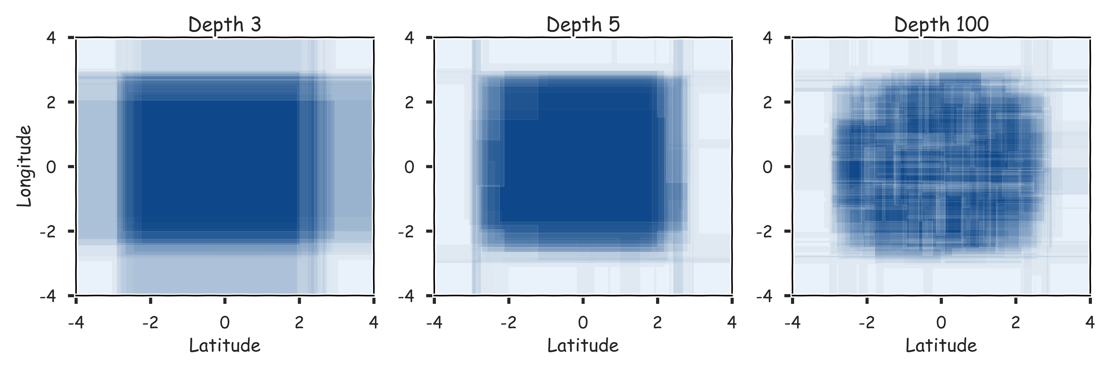
Combine them? 100 magic realisms

Slide 26
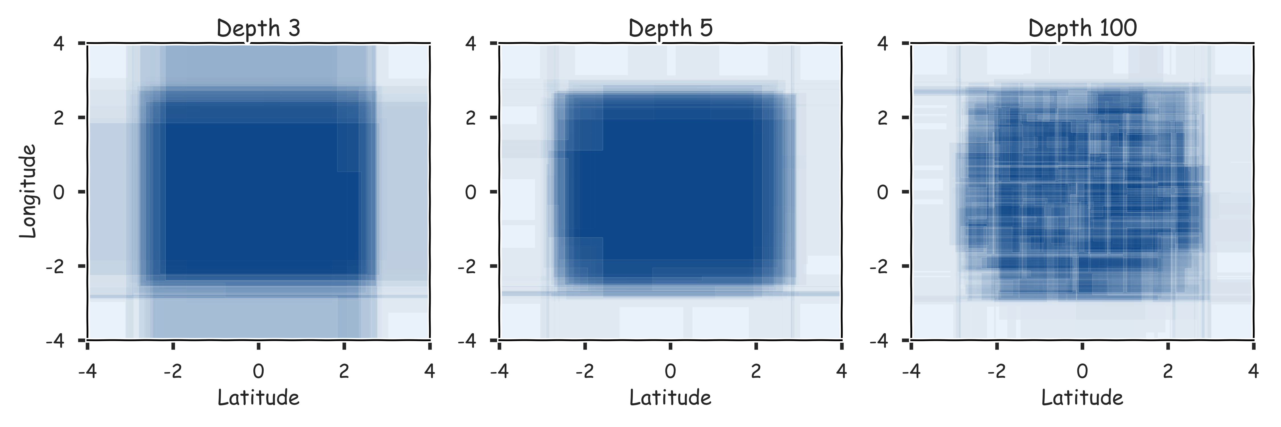
Combine them? 300 magic realisms

Slide 27
Bagging
One way to adjust for the high variance of the output of an experiment is to perform the experiment multiple times and then average the results.
The same idea can be applied to high variance models:
(Bootstrap)we generate multiple samples of training data, via bootstrapping. We train a full decision tree on each sample of data.
(Aggregate)for a given input, we output the averaged outputs of all the models for that input.
For classification, we return the class that is outputted by the plurality of the models. For regression we return the average of the outputs for each tree.
This method is called Bagging (Breiman, 1996), short for, of course, Bootstrap Aggregating.

Slide 28
Bagging
Note that bagging enjoys the benefits of:
High expressiveness - by using full trees each model is able to approximate complex functions and decision boundaries.
Low variance - averaging the prediction of all the models reduces the variance in the final prediction, assuming that we choose a sufficiently large number of trees.

Slide 29
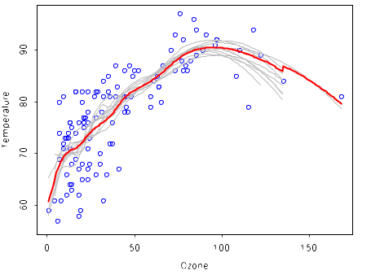
Bagging

Slide 30
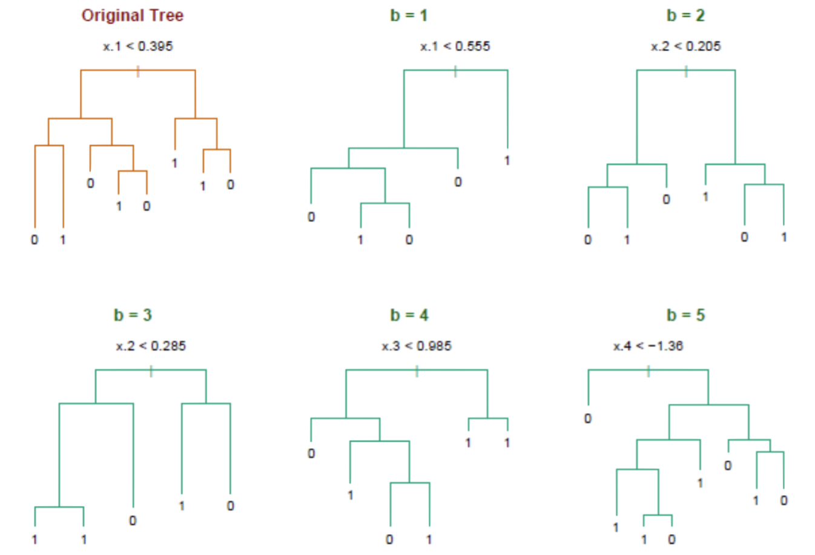
Bagging

Slide 31
Bagging
Question: Do you see any problems?
Still some overfitting if the trees are too large
If trees are too shallow it can still underfits.
Interperability
The major drawback of bagging (and other ensemble methods that we will study) is that the averaged model is no longer easily interpretable - i.e. one can no longer trace the ‘logic’ of an output through a series of decisions based on predictor values!

Slide 32
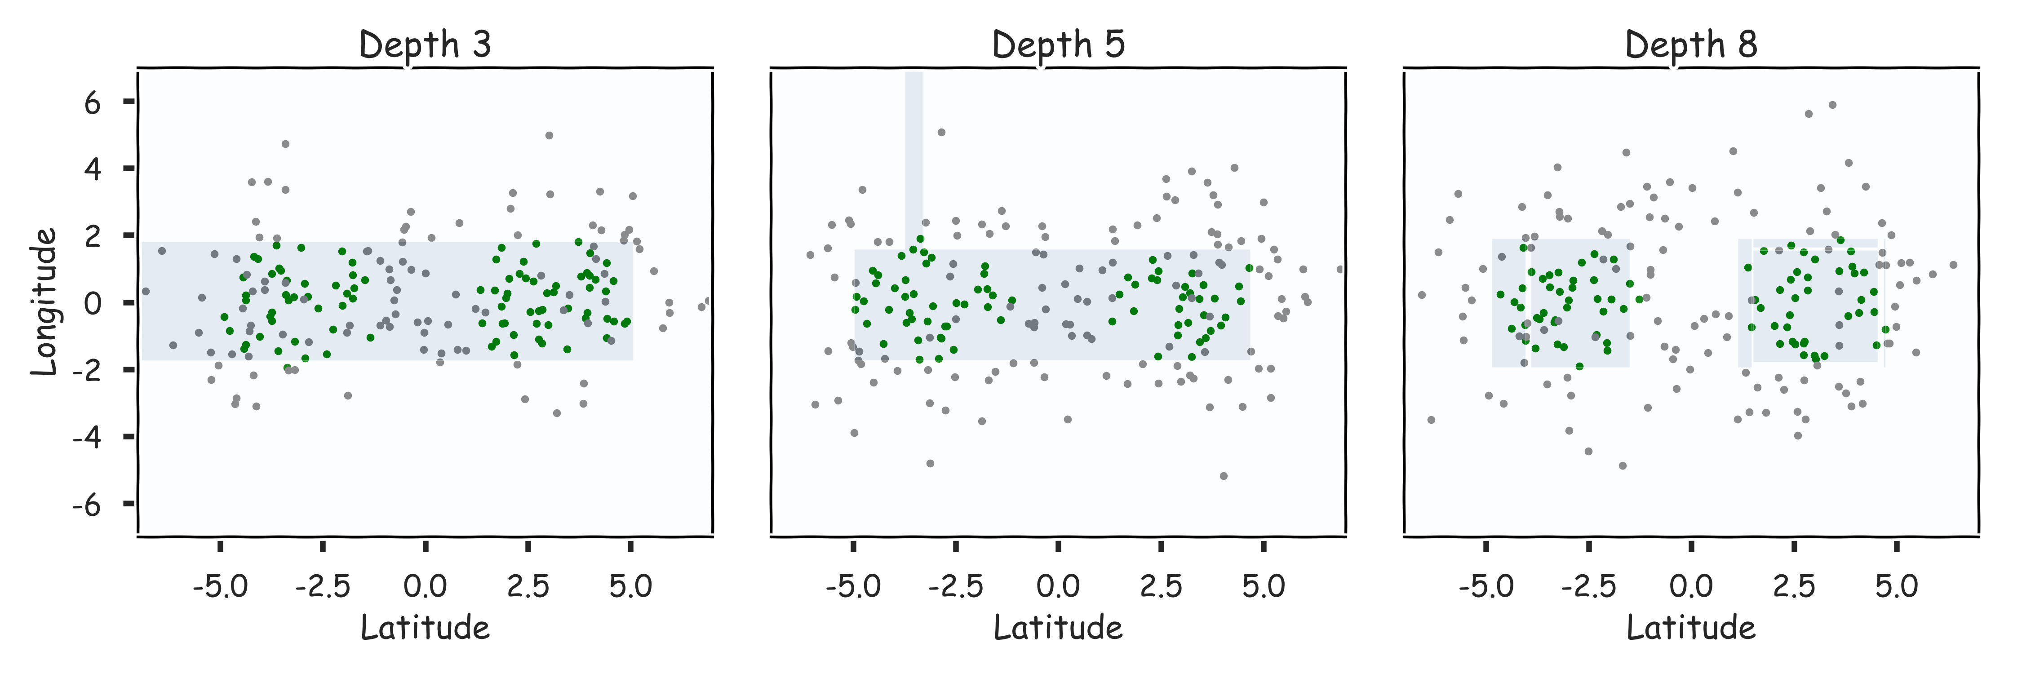
Case of underfitting

Slide 33
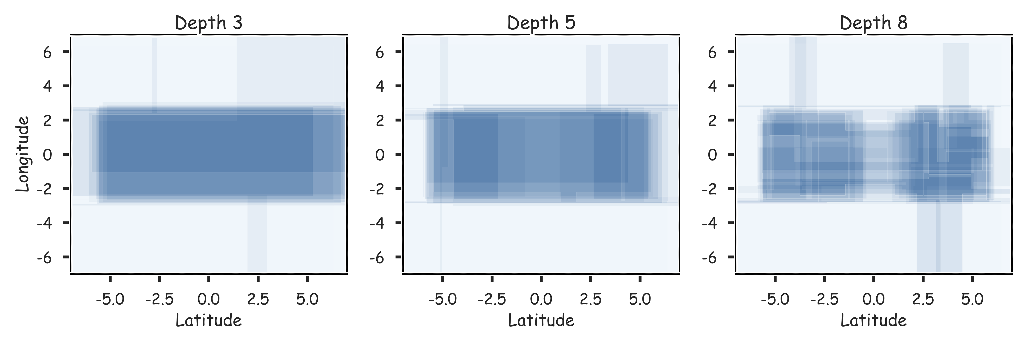
Case of underfitting

Slide 34
Bagging
Question: Do you see any problems?
Still some overfitting if the trees are too large
If trees are too shallow it can still underfits.
Cross Validations

Slide 35
Out-of-Bag Error

Slide 36
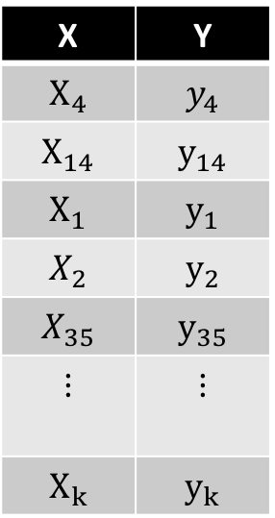
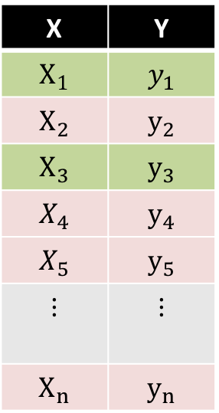

Bagging
Original Data
Bootstrap Sample 1
Decision Tree 1
Used and unused data
X | Y
$$X_{1}$$ | $$y_{1}$$
$$X_{2}$$ | $$y_{2}$$
$$X_{3}$$ | $$y_{3}$$
$$X_{4}$$ | $$y_{4}$$
$$X_{5}$$ | $$y_{5}$$
$$⋮$$ | $$⋮$$
$$X_{n}$$ | $$y_{n}$$
X | Y
$$X_{4}$$ | $$y_{4}$$
$$X_{14}$$ | $$y_{14}$$
$$X_{1}$$ | $$y_{1}$$
$$X_{2}$$ | $$y_{2}$$
$$X_{35}$$ | $$y_{35}$$
$$⋮$$ | $$⋮$$
$$X_{k}$$ | $$y_{k}$$
X | Y
$$X_{1}$$ | $$y_{1}$$
$$X_{2}$$ | $$y_{2}$$
$$X_{3}$$ | $$y_{3}$$
$$X_{4}$$ | $$y_{4}$$
$$X_{5}$$ | $$y_{5}$$
$$⋮$$ | $$⋮$$
$$X_{n}$$ | $$y_{n}$$

Slide 37
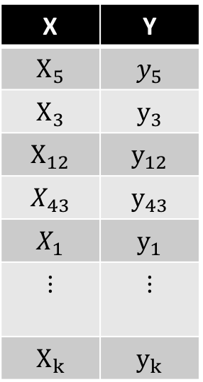
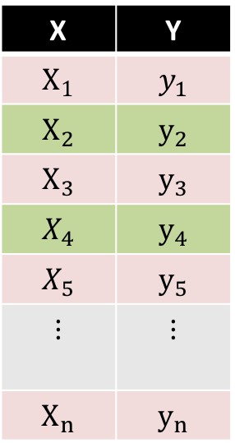
Bagging
Original Data
Bootstrap Sample 2
Decision Tree 2
Used and unused data
X | Y
$$X_{1}$$ | $$y_{1}$$
$$X_{2}$$ | $$y_{2}$$
$$X_{3}$$ | $$y_{3}$$
$$X_{4}$$ | $$y_{4}$$
$$X_{5}$$ | $$y_{5}$$
$$⋮$$ | $$⋮$$
$$X_{n}$$ | $$y_{n}$$
X | Y
$$X_{5}$$ | $$y_{5}$$
$$X_{3}$$ | $$y_{3}$$
$$X_{12}$$ | $$y_{12}$$
$$X_{43}$$ | $$y_{43}$$
$$X_{1}$$ | $$y_{1}$$
$$⋮$$ | $$⋮$$
$$X_{k}$$ | $$y_{k}$$
X | Y
$$X_{1}$$ | $$y_{1}$$
$$X_{2}$$ | $$y_{2}$$
$$X_{3}$$ | $$y_{3}$$
$$X_{4}$$ | $$y_{4}$$
$$X_{5}$$ | $$y_{5}$$
$$⋮$$ | $$⋮$$
$$X_{n}$$ | $$y_{n}$$

Slide 38

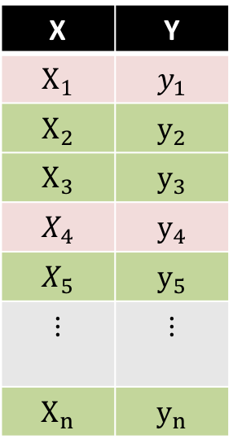
Bagging
Original Data
Bootstrap Sample 3
Decision Tree 3
Used and unused data
X | Y
$$X_{1}$$ | $$y_{1}$$
$$X_{2}$$ | $$y_{2}$$
$$X_{3}$$ | $$y_{3}$$
$$X_{4}$$ | $$y_{4}$$
$$X_{5}$$ | $$y_{5}$$
$$⋮$$ | $$⋮$$
$$X_{n}$$ | $$y_{n}$$
X | Y
$$X_{9}$$ | $$y_{9}$$
$$X_{4}$$ | $$y_{4}$$
$$X_{1}$$ | $$y_{1}$$
$$X_{1}$$ | $$y_{1}$$
$$X_{65}$$ | $$y_{65}$$
$$⋮$$ | $$⋮$$
$$X_{k}$$ | $$y_{k}$$
X | Y
$$X_{1}$$ | $$y_{1}$$
$$X_{2}$$ | $$y_{2}$$
$$X_{3}$$ | $$y_{3}$$
$$X_{4}$$ | $$y_{4}$$
$$X_{5}$$ | $$y_{5}$$
$$⋮$$ | $$⋮$$
$$X_{n}$$ | $$y_{n}$$

Slide 39
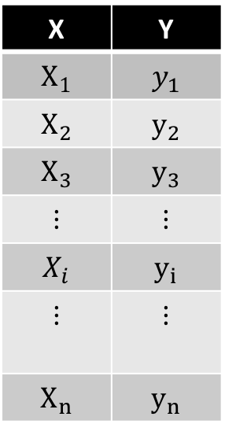
Point-wise out-of-bag error
X | Y
$$X_{1}$$ | $$y_{1}$$
$$X_{2}$$ | $$y_{2}$$
$$X_{3}$$ | $$y_{3}$$
$$⋮$$ | $$⋮$$
$$X_{i}$$ | $$y_{i}$$
$$⋮$$ | $$⋮$$
$$X_{n}$$ | $$y_{n}$$

Slide 40
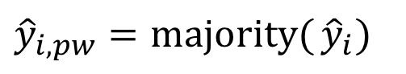
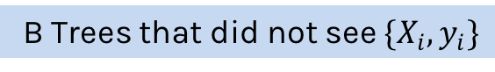
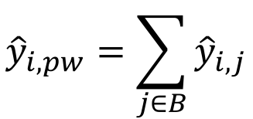
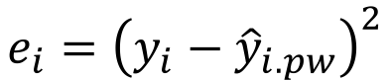
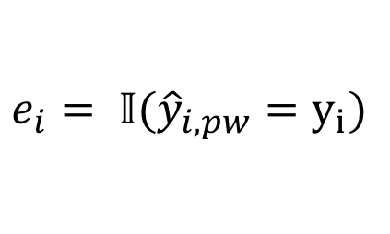
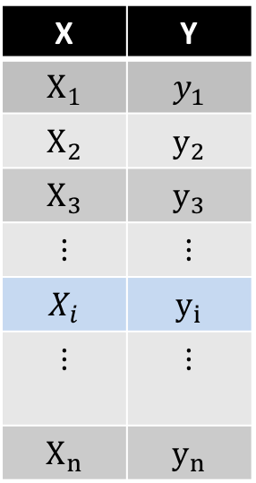
Point-wise out-of-bag error
B Trees that did not see $\{X_{i},y_{i}\}$
X | Y
$$X_{1}$$ | $$y_{1}$$
$$X_{2}$$ | $$y_{2}$$
$$X_{3}$$ | $$y_{3}$$
$$⋮$$ | $$⋮$$
$$X_{i}$$ | $$y_{i}$$
$$⋮$$ | $$⋮$$
$$X_{n}$$ | $$y_{n}$$
Classification
$${\hat{y}}_{i,pw}=majority({{\hat{y}}_{i})}$$
$$e_{i}= 𝕀({\hat{y}}_{i,pw}=y_{i})$$
Regression
$${\hat{y}}_{i,pw}=\sum_{j∈B}{{\hat{y}}_{i,j}}$$
$$e_{i}={\left(y_{i}−{\hat{y}}_{i.pw}\right)}^{2}$$

Slide 41
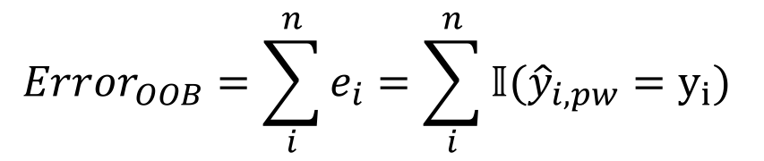
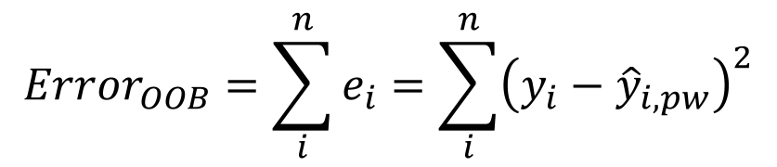
OOB Error
We average the point-wise out-of-bag error over the full training set.
Classification
$$Error_{OOB}=\sum_{i}^{n}{e_{i}}=\sum_{i}^{n}{𝕀({\hat{y}}_{i,pw}=y_{i}) }$$
Regression
$$Error_{OOB}=\sum_{i}^{n}{e_{i}}=\sum_{i}^{n}{{\left(y_{i}−{\hat{y}}_{i,pw}\right)}^{2}}$$

Slide 42
Out-of-Bag Error
Bagging is an example of an ensemble method, a method of building a single model by training and aggregating multiple models.
With ensemble methods, we get a new metric for assessing the predictive performance of the model, the out-of-bag error.
Given a training set and an ensemble of modeled each trained on a bootstrap sample, we compute the out-of-bag error of the averaged model by
For each point in the training set, we average the predicted output for this point over the models whose bootstrap training set excludes this point. We compute the error or squared error of this averaged prediction. Call this the point-wise out-of-bag error.
We average the point-wise out-of-bag error over the full training set.

Slide 43
Bagging
Question: Do you see any problems?
Still some overfitting if the trees are too large
If trees are too shallow it can still underfits.
interpretability
The major drawback of bagging (and other ensemble methods that we will study) is that the averaged model is no longer easily interpretable - i.e. one can no longer trace the ‘logic’ of an output through a series of decisions based on predictor values!

Slide 44
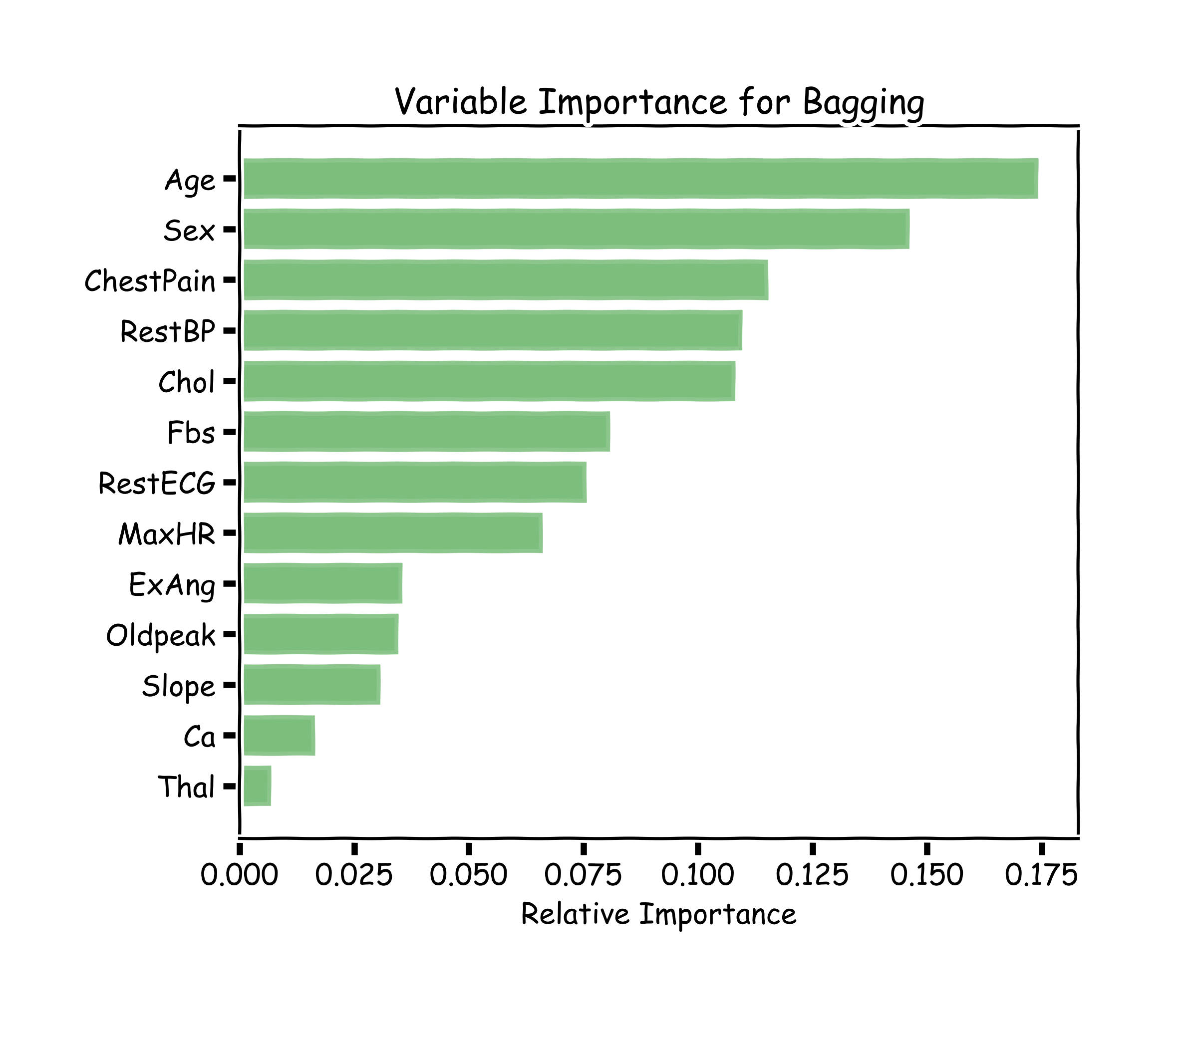
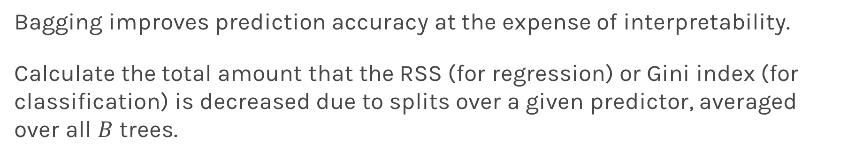
Variable Importance for Bagging
Bagging improves prediction accuracy at the expense of interpretability.
Calculate the total amount that the RSS (for regression) or Gini index (for classification) is decreased due to splits over a given predictor, averaged over all $B$ trees.
100 trees, max_depth=10

Slide 45
Bagging
Question: Do you see any problems?
Still some overfitting if the trees are too large
If trees are too shallow it can still underfits.
interpretability
The major drawback of bagging (and other ensemble methods that we will study) is that the averaged model is no longer easily interpretable - i.e. one can no longer trace the ‘logic’ of an output through a series of decisions based on predictor values!

Slide 46
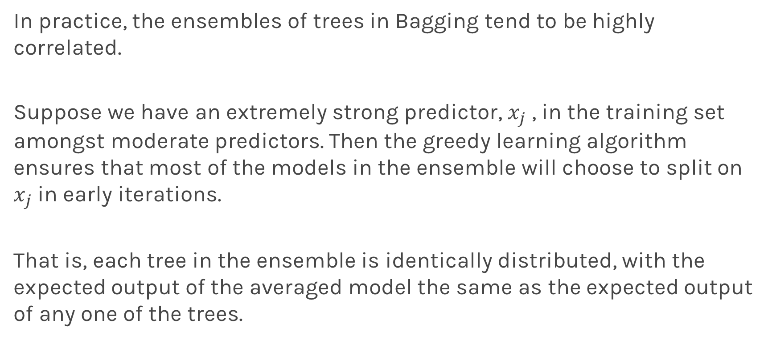
Improving on Bagging
In practice, the ensembles of trees in Bagging tend to be highly correlated.
Suppose we have an extremely strong predictor, $x_{j}$ , in the training set amongst moderate predictors. Then the greedy learning algorithm ensures that most of the models in the ensemble will choose to split on $x_{j}$ in early iterations.
That is, each tree in the ensemble is identically distributed, with the expected output of the averaged model the same as the expected output of any one of the trees.

Slide 47
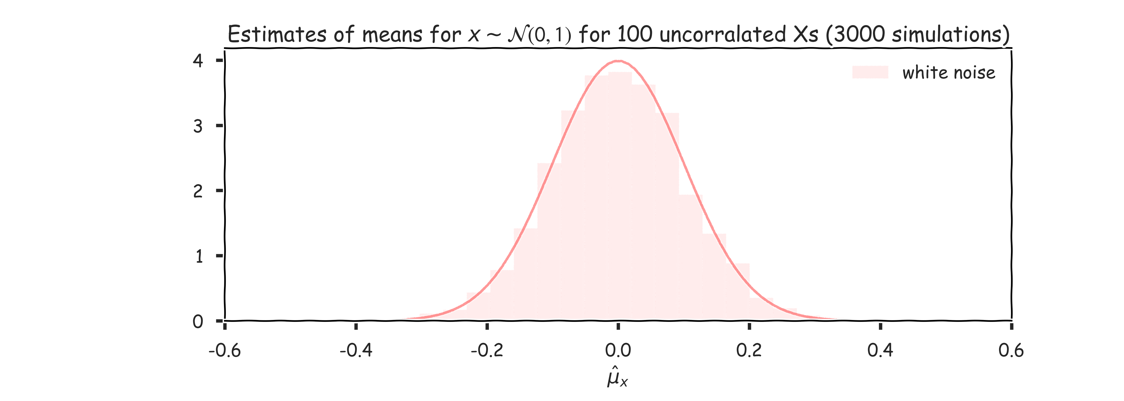
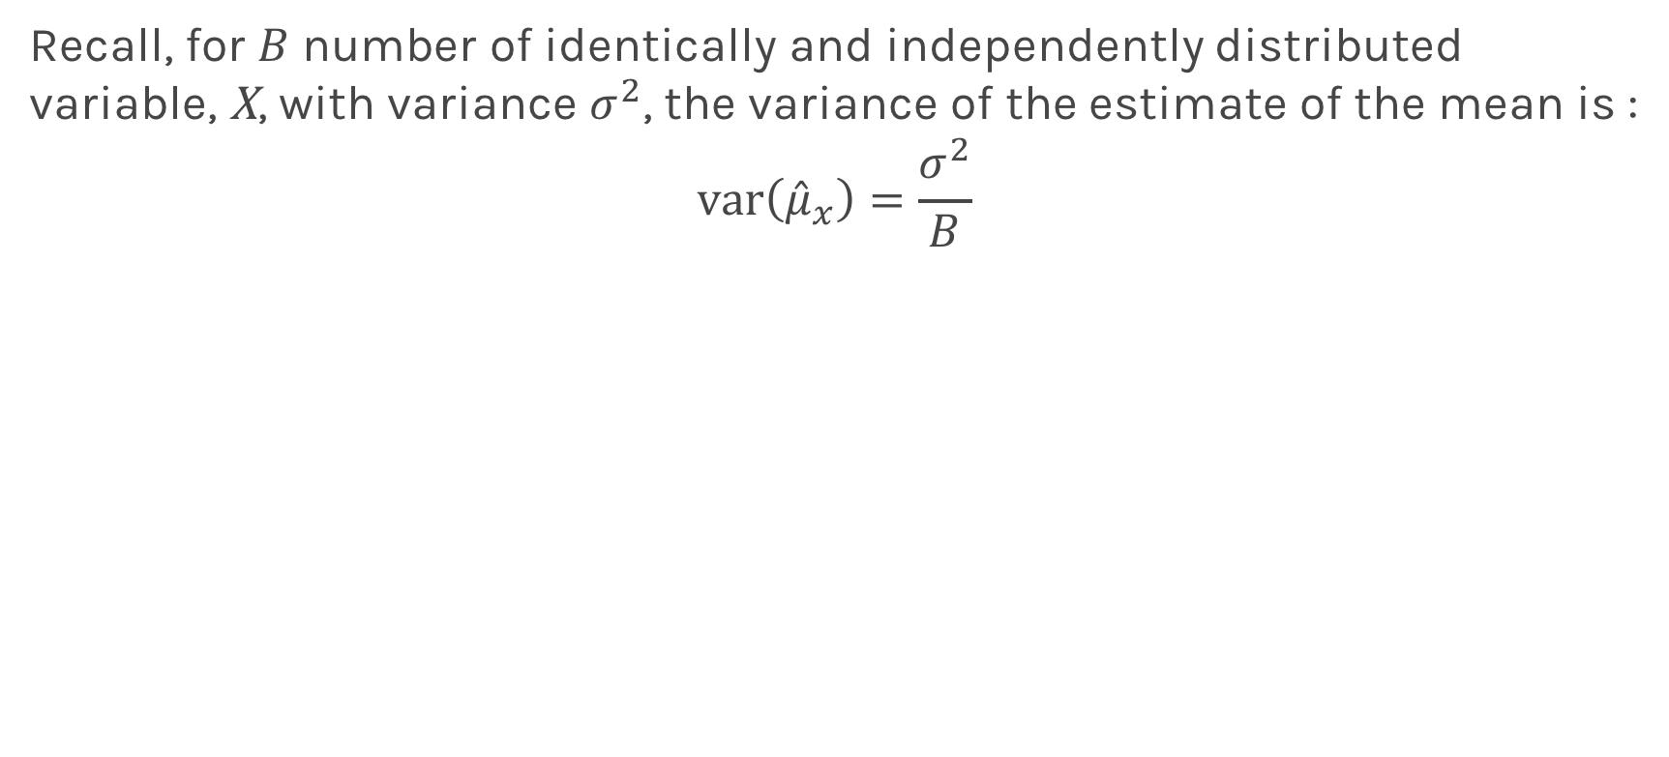
Improving on Bagging
Recall, for $B$ number of identically and independently distributed variable, X, with variance $σ^{2}$, the variance of the estimate of the mean is :
$$var\left({\hat{μ}}_{x}\right)=\frac{σ^{2}}{B}$$

Slide 48
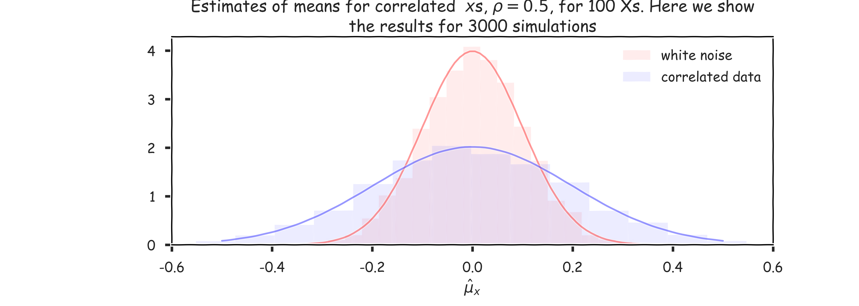
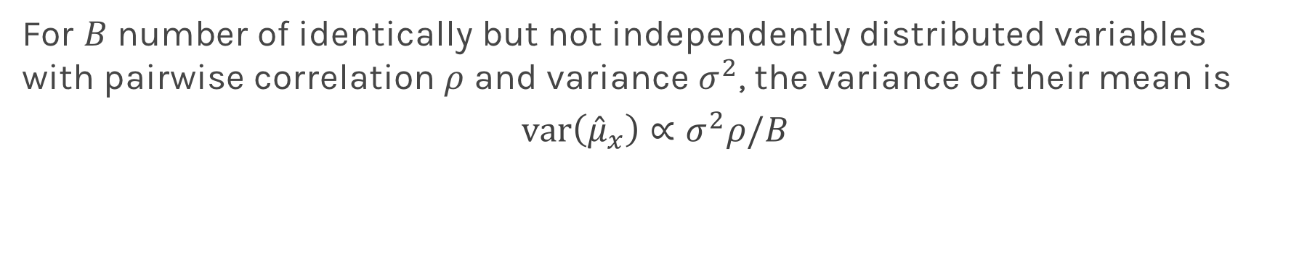
Improving on Bagging
For $B$ number of identically but not independently distributed variables with pairwise correlation $ρ$ and variance $σ^{2}$, the variance of their mean is
$$var\left({\hat{μ}}_{x}\right)∝σ^{2}ρ/B$$

Slide 49
Bagging
Question: Do you see any problems?
Still some overfitting if the trees are too large
If trees are too shallow it can still underfits.
interpretability
The major drawback of bagging (and other ensemble methods that we will study) is that the averaged model is no longer easily interpretable - i.e. one can no longer trace the ‘logic’ of an output through a series of decisions based on predictor values!

Slide 50
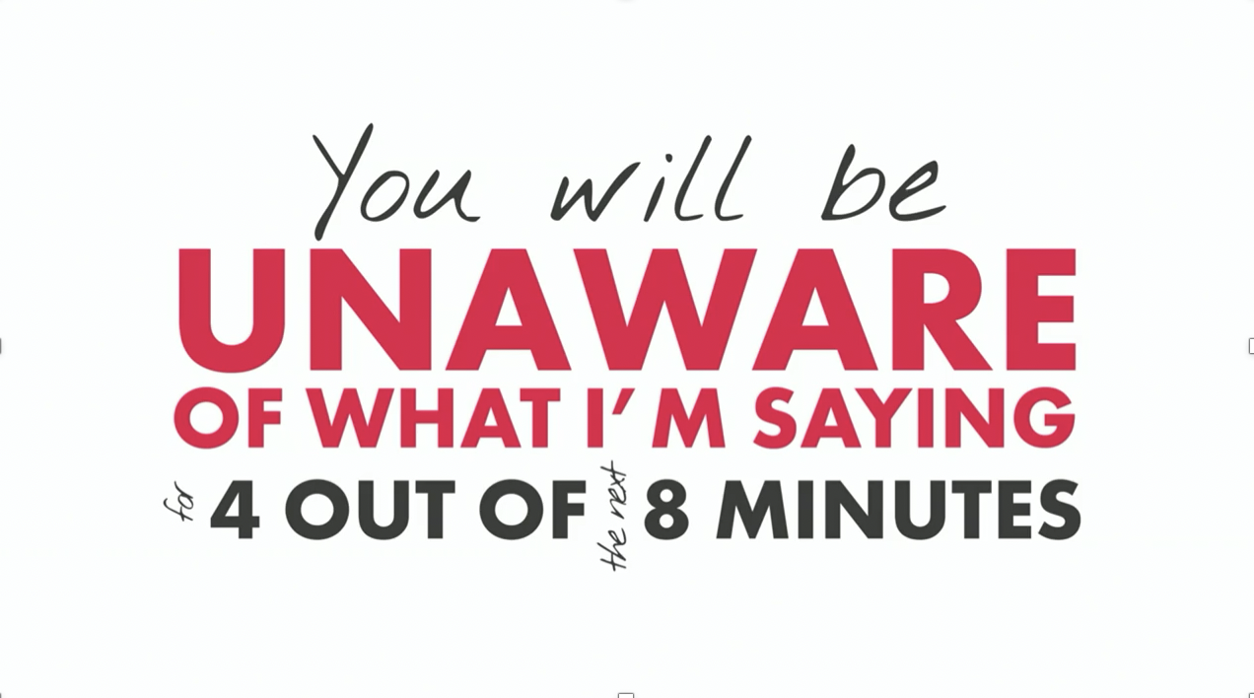
Zeenat Potia

Slide 51
Random Forests

Slide 52
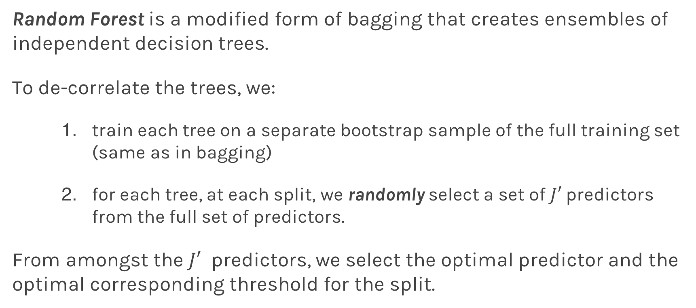
Random Forests
Random Forest is a modified form of bagging that creates ensembles of independent decision trees.
To de-correlate the trees, we:
train each tree on a separate bootstrap sample of the full training set (same as in bagging)
for each tree, at each split, we randomly select a set of $J′$ predictors from the full set of predictors.
From amongst the $J′$ predictors, we select the optimal predictor and the optimal corresponding threshold for the split.

Slide 53
Tuning Random Forests
Random forest models have multiple hyper-parameters to tune:
the number of predictors to randomly select at each split
the total number of trees in the ensemble
the minimum leaf node size
In theory, each tree in the random forest is full, but in practice this can be computationally expensive (and added redundancies in the model), thus, imposing a minimum node size is not unusual.

Slide 54
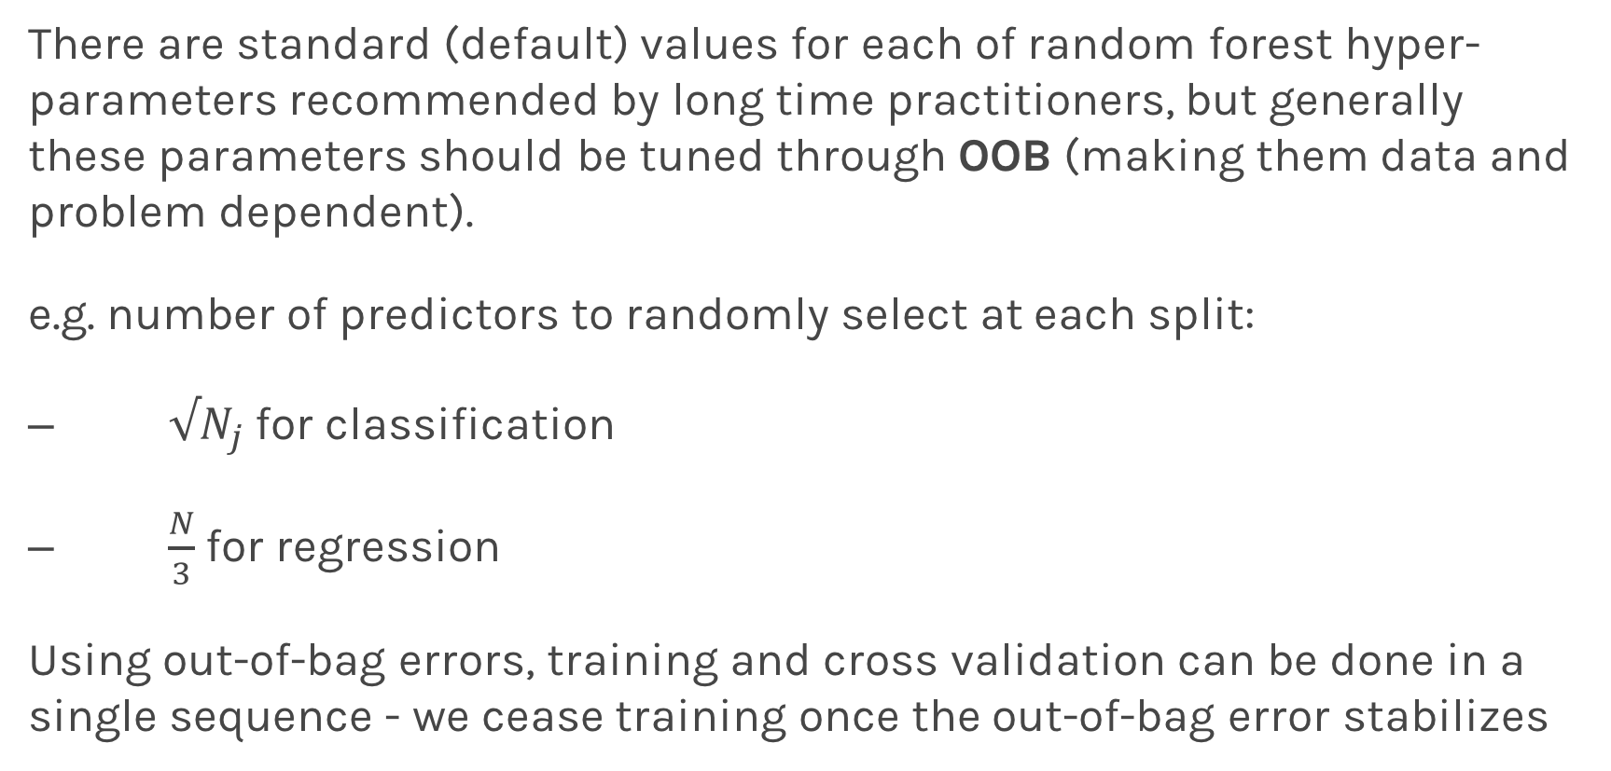
Tuning Random Forests
There are standard (default) values for each of random forest hyper-parameters recommended by long time practitioners, but generally these parameters should be tuned through OOB (making them data and problem dependent).
e.g. number of predictors to randomly select at each split:
$√N_{j}$ for classification
$\frac{N}{3}$ for regression
Using out-of-bag errors, training and cross validation can be done in a single sequence - we cease training once the out-of-bag error stabilizes

Slide 55
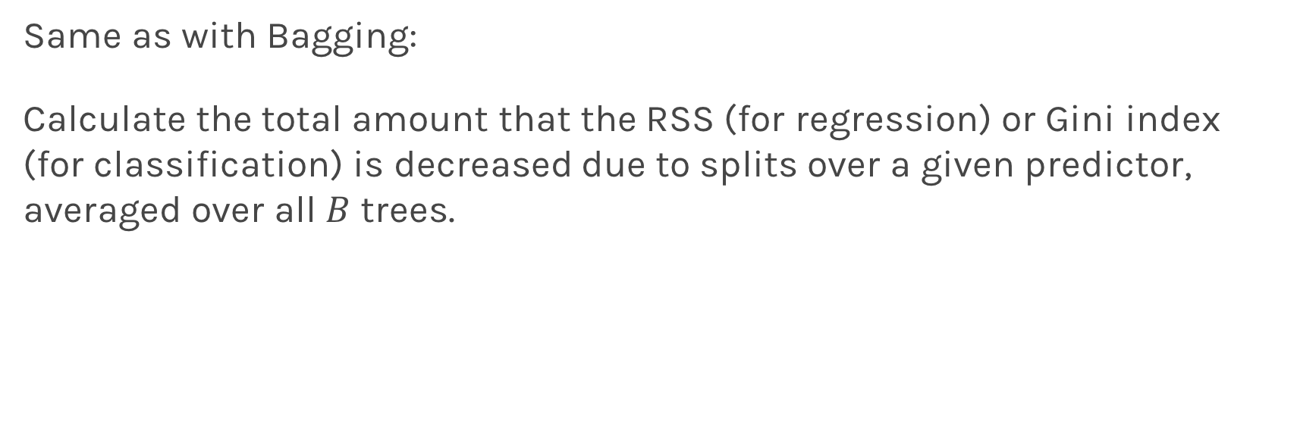
Variable Importance for RF
Same as with Bagging:
Calculate the total amount that the RSS (for regression) or Gini index (for classification) is decreased due to splits over a given predictor, averaged over all $B$ trees.

Slide 56
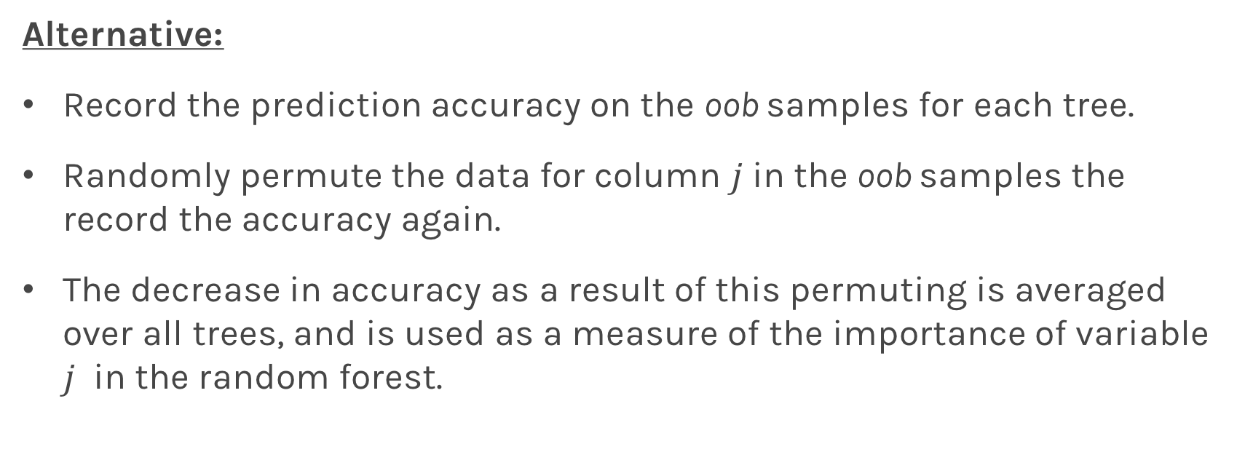
Variable Importance for RF
Alternative:
Record the prediction accuracy on the oob samples for each tree.
Randomly permute the data for column $j$in the oob samples the record the accuracy again.
The decrease in accuracy as a result of this permuting is averaged over all trees, and is used as a measure of the importance of variable $j$ in the random forest.

Slide 57
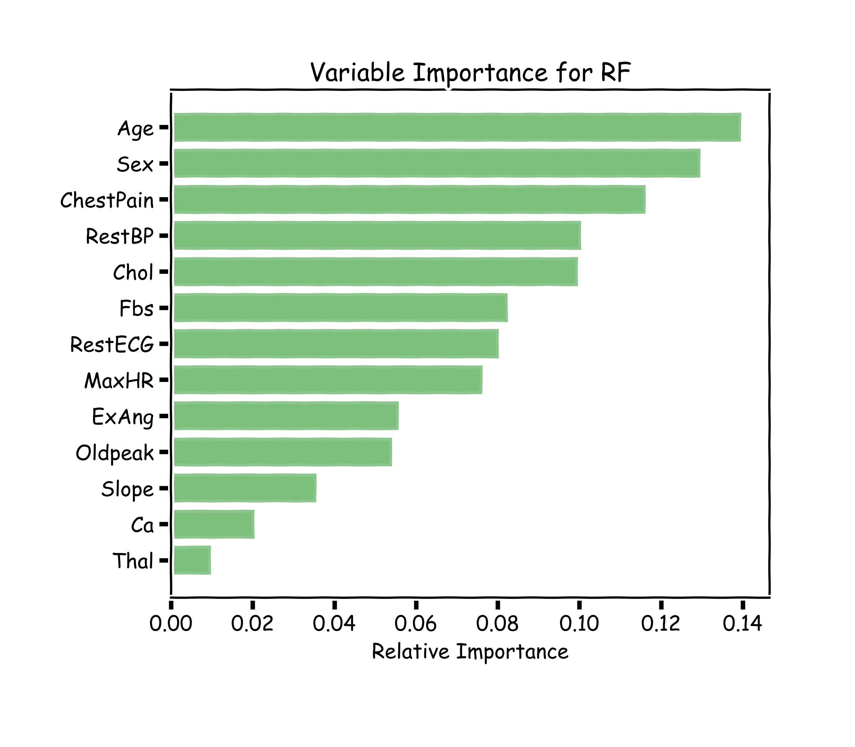
Variable Importance for RF
100 trees, max_depth=10

Slide 58

Variable Importance for RF
100 trees, max_depth=10

Slide 59
Final Thoughts on Random Forests
When the number of predictors is large, but the number of relevant predictors is small, random forests can perform poorly.
Question: Why?
In each split, the chances of selected a relevant predictor will be low and hence most trees in the ensemble will be weak models.

Slide 60
Final Thoughts on Random Forests (cont.)
Increasing the number of trees in the ensemble generally does not increase the risk of overfitting.
Again, by decomposing the generalization error in terms of bias and variance, we see that increasing the number of trees produces a model that is at least as robust as a single tree.
However, if the number of trees is too large, then the trees in the ensemble may become more correlated, increase the variance.

Slide 61
Final Thoughts on Random Forests (cont.)
Probabilities:
Random Forrest Classifier (and bagging) can return probabilities.
Question: How?
Unbalance dataset:
Weighted samples:
Categorical data:
Missing data: a-sec later today
Different implementations: : a-sec later today

